Slide 1
Electrophilic aromatic substitution – Nitration of benzene

Slide 2
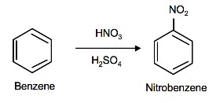
Nitration of Benzene
The source of the nitronium ion is through the protonation of nitric acid by sulfuric acid, which causes the loss of a water molecule and formation of a nitronium ion.

Slide 3
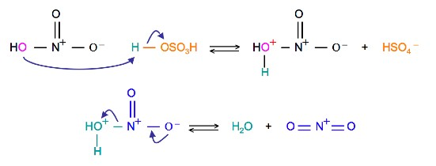
The first step in the nitration of benzene is to activate HNO₃with sulfuric acid to produce a stronger electrophile, the nitronium ion.
The first step in the nitration of benzene is to activate HNO₃with sulfuric acid to produce a stronger electrophile, the nitronium ion.
Because the nitronium ion is a good electrophile, it is attacked by benzene to produce Nitrobenzene.

Slide 4
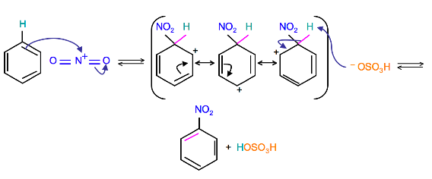
Mechanism
(Resonance forms of the intermediate can be seen in the generalized electrophilic aromatic substitution)

Slide 5
Nitration of benzene firstly involves the formation of a very powerful electrophile, the nitronium ion, which is linear. This occurs following the interaction of two strong acids, sulfuric and nitric acid. Sulfuric acid is the stronger and it protonates the nitric acid on the OH group so that a molecule of water can leave. Benzene attacks the positively charged nitrogen atom of the electrophile, where one of the N=O bonds is broken at the same time. This is followed by rapid loss of a proton to regenerate the aromaticity.

Slide 6
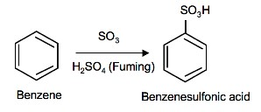
Sulfonation is a reversible reaction that produces benzenesulfonic acid by adding sulfur trioxide and fuming sulfuric acid. The reaction is reversed by adding hot aqueous acid to benzenesulfonic acid to produce benzene.

Slide 7
To produce benzenesulfonic acid from benzene, fuming sulfuric acid and sulfur trioxide are added. Fuming sulfuric acid, also refered to as oleum, is a concentrated solution of dissolved sulfur trioxide in sulfuric acid. The sulfur in sulfur trioxide is electrophilic because the oxygens pull electrons away from it because oxygen is very electronegative. The benzene attacks the sulfur (and subsequent proton transfers occur) to produce benzenesulfonic acid.

Slide 8
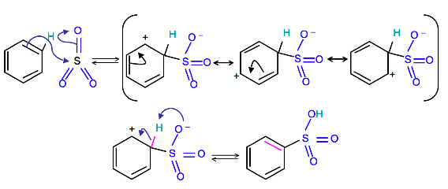
.
acid.
Reverse Sulfonation

Slide 9
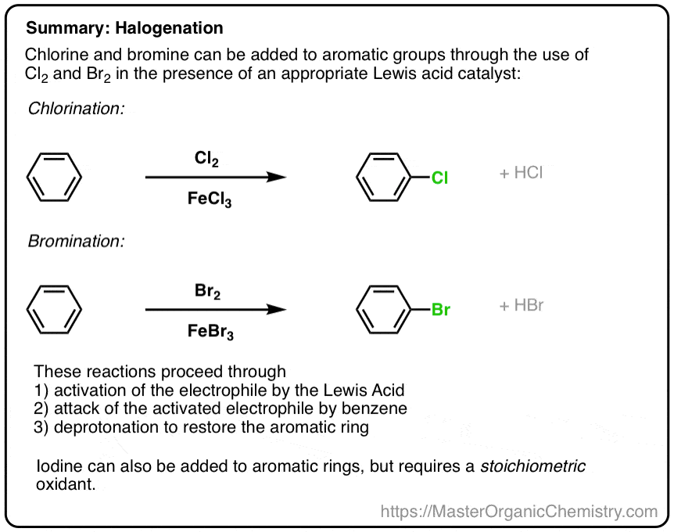

Slide 10
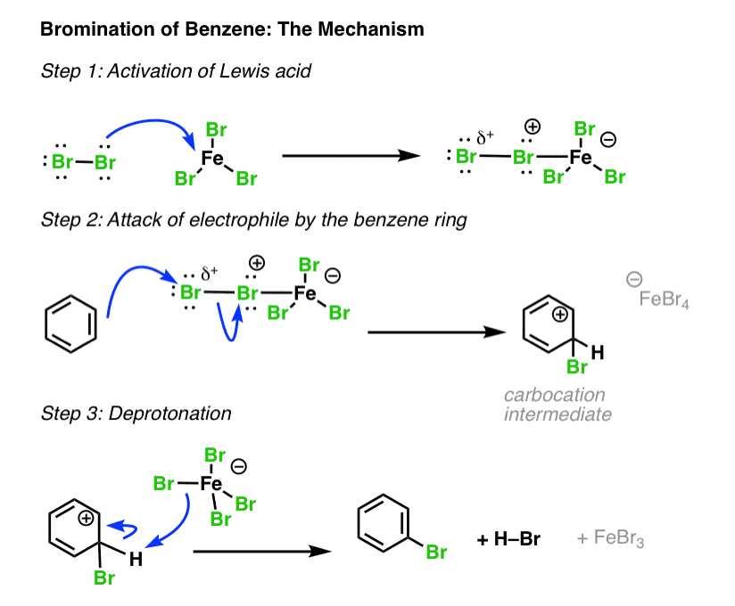
as before:

Slide 11
Summary: Halogenation of Benzene
In the cases of chlorine, bromine, and iodine, electrophilic aromatic substitution follows three steps.
Activation of the electrophile by a Lewis acid catalyst (or stoichiometric oxidant, in the case of iodine)
Attack of the activated electrophile by the aromatic ring.
Deprotonation to regenerate the aromatic ring.
In the next post we’ll cover two more important electrophilic aromatic substitution reactions: sulfonylation and nitration, and they will also follow this three-step pattern!

Slide 12
Electrophilic substitution reaction of benzene
What is alkylation?
Alkylation means substituting an alkyl group into something - in this case into a benzene ring. A hydrogen on the ring is replaced by a group like methyl or ethyl and so on.
The facts
Benzene is treated with a chloroalkane (for example, chloromethane or chloroethane) in the presence of aluminium chloride as a catalyst. On this page, we will look at substituting a methyl group, but any other alkyl group could be used in the same way.
Substituting a methyl group gives methylbenzene - once known as toluene.

Slide 13
The aluminium chloride isn't written into these equations because it is acting as a catalyst. If you wanted to include it, you could write AlCl₃ over the top of the arrow.
The formation of the electrophile
The electrophile is CH₃⁺. It is formed by reaction between the chloromethane and the aluminium chloride catalyst.

Slide 14
The electrophilic substitution mechanism
Stage one
Stage two
The hydrogen is removed by the AlCl₄⁻ ion which was formed at the same time as the CH₃⁺ electrophile. The aluminium chloride catalyst is re-generated in this second stage

